Slide 1
Model View Controller (MVC) an architecture
Rick Mercer with help from many of others

Slide 2
Model View Controller (MVC)
The intent of MVC is to keep neatly separate objects into one of tree categories
  Model
    The data, the business logic, rules, strategies, and so on
  View
    Displays the model and usually has components that allows user to edit change the model
  Controller
    Allows data to flow between the view and the model
    The controller mediates between the view and model

Slide 3
Model
The Model's responsibilities
  Provide access to the state of the system
  Provide access to the system's functionality
  Can notify the view(s) that its state has changed

Slide 4
View
The view's responsibilities
  Display the state of the model to the user
At some point, the model (a.k.a. the observable) must registers the views (a.k.a. observers) so the model can notify the observers that its state has changed

Slide 5
Controller
The controller's responsibilities
  Accept user input
    Button clicks, key presses, mouse movements, slider bar changes
  Send messages to the model, which may in turn notify it observers
  Send appropriate messages to the view
In Java, listeners are controllers

Slide 6
MVC Misunderstood
MVC is understood by different people in different ways
It is often misunderstood, but most software developers will say it is important; powerful
Lets start it right:
  MVC is a few patterns put together

Slide 7
Smalltalk-80™
In the MVC paradigm, the user input, the modeling of the external world, and the visual feedback to the user are explicitly separated and handled by three types of objects, each specialized for its task.
  The view manages the graphical and/or textual output to the portion of the bitmapped display that is allocated to its application.
  The controller interprets the mouse and keyboard inputs from the user, commanding the model and/or the view to change as appropriate.
  The model manages the behavior and data of the application domain, responds to requests for information about its state (usually from the view), and responds to instructions to change state (usually from the controller).

Slide 8
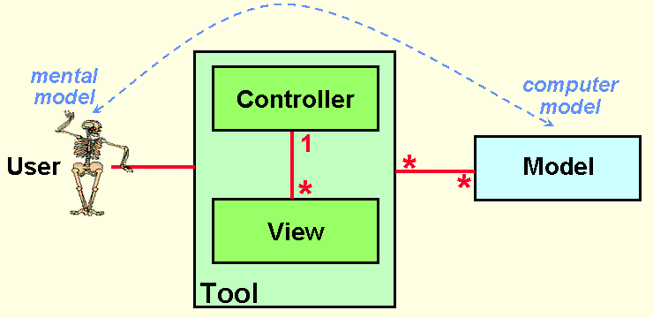
Smalltalk-80™ continued
The formal separation of these three tasks is an important notion that is particularly suited to MVC Smalltalk-80 where the basic behavior can be embodied in abstract objects: View, Controller, Model, and Object
MVC discovered by Trygve Reenskaug in 1979

Slide 9
Sun says
Model-View-Controller ("MVC") is the recommended architectural design pattern for interactive applications
MVC organizes an interactive application into three separate modules:
  one for the application model with its data representation and business logic,
  the second for views that provide data presentation and user input, and
  the third for a controller to dispatch requests and control flow.

Slide 10
Sun continued
Most Web-tier application frameworks use some variation of the MVC design pattern
The MVC (architectual) design pattern provides a host of design benefits

Slide 11
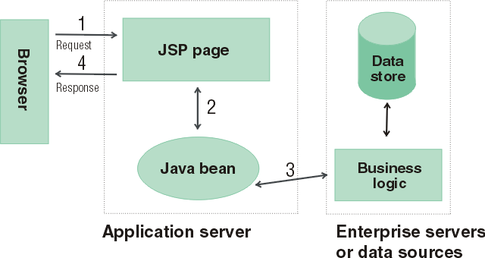
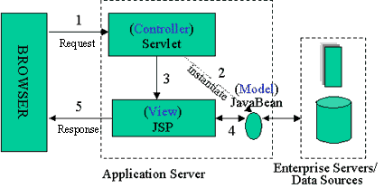
Java Server Pages
Model 2 Architecture to serve dynamic content
  Model: Enterprise Beans with data in the DBMS
    JavaBean: a class that encapsulates objects and can be displayed graphically
  Controller: Servlets create beans, decide which JSP to return, do the bulk of the processing
  View: The JSPs generated in the presentation layer (the browser)

Slide 12
OO-tips writes
The MVC paradigm is a way of breaking an application, or even just a piece of an application's interface, into three parts: the model, the view, and the controller.
MVC was originally developed to map the traditional input, processing, output roles into the GUI realm:
  Input --> Processing --> Output
  Controller --> Model --> View

Slide 13
Wikipedia writes
Model-View-Controller (MVC) is a software architecture that separates an application's data model, user interface, and control logic into three distinct components so that modifications to one component can be made with minimal impact to the others.
MVC is often thought of as a software design pattern. However, MVC encompasses more of the architecture of an application than is typical for a design pattern. Hence the term architectural pattern may be useful (Buschmann, et al 1996), or perhaps an aggregate design pattern.

Slide 14
MVC Benefits
Clarity of design
  easier to implement and maintain
Modularity
  changes to one doesn't affect other modules
  can develop in parallel once you have the interfaces
Multiple views
  games, spreadsheets, powerpoint, Eclipse, UML reverse engineering, ….

Slide 15
Summary (MVC)
The intent of MVC is to keep neatly separate objects into one of tree categories
  Model
    The data, the business logic, rules, strategies, and so on
  View
    Displays the model and often has components to allow users to change the state of the model
      Imagine pressing arrow on a HuntTheWumpus view Demo JeyPressed
  Controller
    Allows data to flow between the view and the model
    The controller mediates between the view and model

Slide 16
Model
The Model's responsibilities
  Provide access to the state of the model
    getters, toString, other methods that provide info
  Provide access to the system's functionality
    changeRoom(int), shootArrow(int)
  Notify the view(s) that its state has changed
// If extending Java’s Obervable class, do NOT forget
// to tell yourself your state has changed
super.setChanged();
// Otherwise, the next notifyObservers message will not
// send update messages to the registered Observers
this.notifyObservers();

Slide 17
View
The view's responsibilities
  Display the state of the model to users, accept input
The model (a.k.a. the Observable) must register the views (a.k.a. Observers) so the model can notify the observers that its state has changed
  Java’s Observer/Observable support provides
  public void addObserver(Observer o)
  // Adds an observer to the set of observers for this
  // object, provided that it is not the same as some
  // observer already in the set.

Slide 18
Controller
The controller's responsibilities
  Respond to user input (events)
    Button click, key press, mouse click, slider bar change
  Send messages to the model, which may in turn notify it observers
  Send appropriate messages to the view
In Java, controllers are implemented as listeners
  An ActionListener object and its actionPerformed method is a Controller

Slide 19
Swapping Views
Relevant to current project, you will be asked need to swap JPanels (the two Java views)
  In our Observer_Simple example, this controller removes and adds Jpanels with this code
TwoObserversMain.this.remove(currentView);
// Set currentView to one of the Observers the extends JPanel
currentView = … the one selected …
// To access the enclosing class use ClassName.this
TwoObserversMain.this.add(currentView);
// I needed both of these refreshes, at least in older Java
TwoObserversMain.this.validate();
TwoObserversMain.this.repaint();
16-<number>

Slide 20
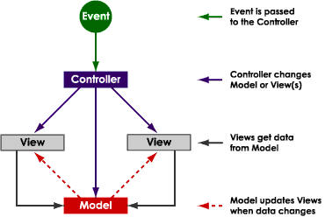
One view of MVC

Slide 21
MVC Misunderstood
MVC is understood by different people in different ways
It is often misunderstood, but most software developers will say it is important; powerful
I believe we started it correctly

Slide 22
MVC in an Old Project TicTacToe
TextFieldView
row _ _ O
_ X _
column _ _ _
DrawingView
ActionListener
MouseListener
Game

Slide 23
Questions
Do controllers have a user interface?
Does a view allow user input?
Can a view send messages to the model?
Can a view send messages to the controller?
Can you have more than one view?
Can a system have more than one controller?

